Slide 1



Kafka vs RabbitMQ
#TechTalkByArvind

Slide 2

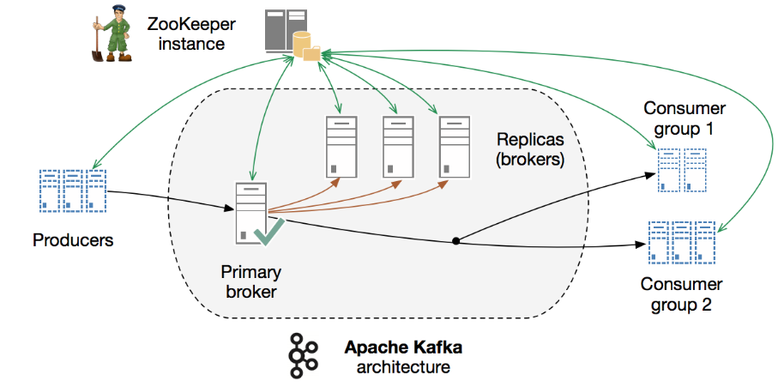
Kafka® is used for building real-time data pipelines and streaming apps.
It is horizontally scalable, fault-tolerant, wicked fast.
Building
real-time streaming data pipelines that reliably get data between systems or applications
real-time streaming applications that transform or react to the streams of data

Slide 3

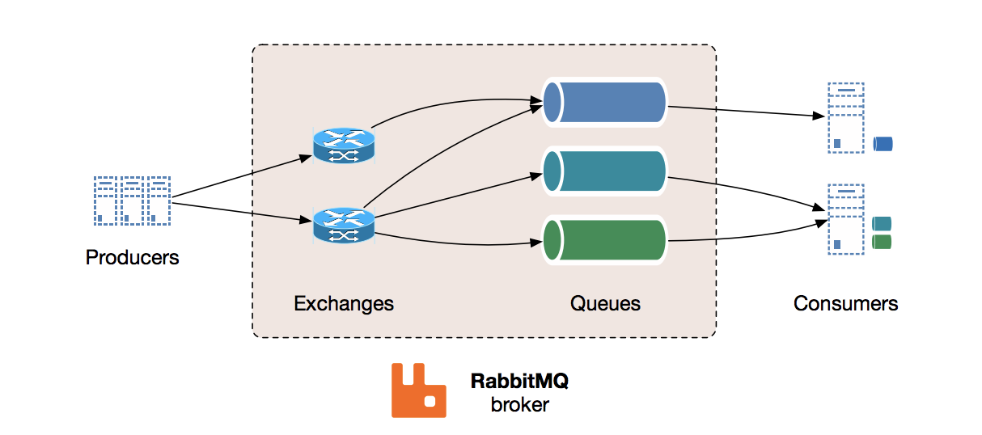
RabbitMQ is a message broker: it accepts and forwards messages

Slide 4
Smilarities
Messaging services
Although both platforms handle messaging differently, the difference lies in their selected architecture, design, and approach to delivery.
Open source for streaming data as well as pub-sub model

Slide 5
References
https://tanzu.vmware.com/content/blog/understanding-when-to-use-rabbitmq-or-apache-kafka
https://medium.com/better-programming/kafka-vs-rabbitmq-why-use-kafka-8401b2863b8b
https://www.rabbitmq.com/
https://kafka.apache.org/intro
https://www.confluent.io/kafka-vs-pulsar/
https://www.upsolver.com/blog/kafka-versus-rabbitmq-architecture-performance-use-case
https://www.cloudamqp.com/blog/2019-12-12-when-to-use-rabbitmq-or-apache-kafka.html

